Slide 1

SkillSphere: Empowering Students
SkillSphere is an all-in-one platform empowering students to teach, learn, and grow. It combines peer learning, resource trading, and internships with blockchain-verified certifications and endorsements. Students earn points by teaching and sharing, trade study materials securely, and access real-world opportunities through skill assessments and projects.

Slide 2
Bridging the Gap: Education and Industry
Industry-Relevant Skills
Real-World Experiences
SkillSphere focuses on practical, industry-relevant skills that students can apply in real-world settings.
Students gain valuable experience through internships, projects, and collaboration with industry professionals.

Slide 3
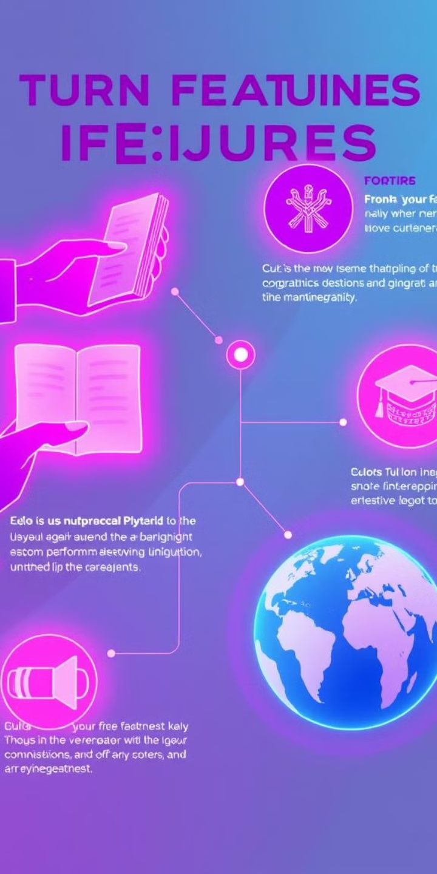
Key Features of SkillSphere
Peer Learning
Resource Trading
Students can teach and learn from each other, building a collaborative learning community.
Students can securely trade study materials, ensuring quality and transparency.
Internships
Certifications
SkillSphere provides opportunities for students to gain real-world experience and build their resumes.
Blockchain-verified certifications add credibility to students' skills and achievements.

Slide 4




Peer Learning: Share Knowledge, Earn Points
Teach
Learn
Collaborate
Students earn points for sharing their knowledge, creating tutorials, and answering questions.
Students can access a library of resources, learn from experts, and engage in discussions.
Peer learning fosters collaboration, building connections and supporting student growth.

Slide 5

Resource Trading: Secure Transactions, Verified Quality
Secure Platform
Verified Quality
SkillSphere uses blockchain technology to ensure secure and transparent transactions for study materials.
Resources are reviewed and verified for quality, ensuring students receive accurate and valuable information.
Earning Points
Students earn points for sharing and selling high-quality study materials, encouraging contribution.

Slide 6

Internships and Real-World Opportunities
1
Skill Assessments
Students can demonstrate their skills through assessments, showcasing their abilities to potential employers.
2
Projects
Students can participate in real-world projects, gaining practical experience and building their portfolios.
3
Internship Matchmaking
SkillSphere connects students with relevant internships, providing opportunities for career growth.

Slide 7




Blockchain-Powered Certifications and Endorsements
Verified Credentials
Blockchain technology ensures the authenticity and immutability of certifications, boosting student credibility.
Endorsements
Students can receive endorsements from mentors, instructors, and employers, further validating their skills.
Global Recognition
Blockchain-powered certifications are recognized globally, opening doors for students worldwide.

Slide 8



Cutting-Edge Technology: React.js, Node.js, Ethereum, IPFS
Blockchain
1
Ethereum provides a secure and transparent platform for storing and verifying data.
Frontend Development
2
React.js delivers a dynamic and user-friendly interface for students and educators.
Backend Development
3
Node.js powers the platform's functionality, providing a robust and scalable backend.

Slide 9

Conclusion: SkillSphere, the Future of Education and Growth
1
2
3
Empowerment
Innovation
Impact
SkillSphere empowers students to take control of their learning, build valuable skills, and access opportunities.
By leveraging cutting-edge technologies, SkillSphere is driving innovation in the education space.
SkillSphere has the potential to significantly impact the way students learn, develop, and succeed in the future.

